Slide 1

Want to buy
Mobile Phone
Shop A
Shop B
Shop C
Only Gives
Mobile Phone
Mobile Phone
Free SIM Card
Mobile Phone
Free SIM Card
Free Currency for 1 Month
Free Internet for 3 Months
You
Imagine all these persons belongs to same criteria
For example : through out 70%, Passed out in 2013, BE in CS, etc
Company
Person A
Person B
Person C
Want to hire
A fresher
Knows Only C
Knows C & Java
Knows
C
Java
J2EE
Frameworks

Slide 2
IT Requirements
1990 to 1999
2006 to till date
No. of Engineers
passed out per year
Few reasons why there is decrease in No. of IT Openings
1. Outsourcing countries polices got changed
2. Increase in the cost in India (real estate, salary expectation etc.,)
3. Increase in competition (company wise & engineers wise)
4. Competition from other countries ex: China, Philippines

Slide 4



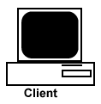
Client Tier
Business Tier
Database Tier
MySQL DB
www.gmail.com
1
Web Application
PHP
CGI
ASP .Net
J2EE
Login Page
User ID & Password
2
Oracle DB
Inbox Page
Login Page along
with Error Info
Informix DB

Slide 5
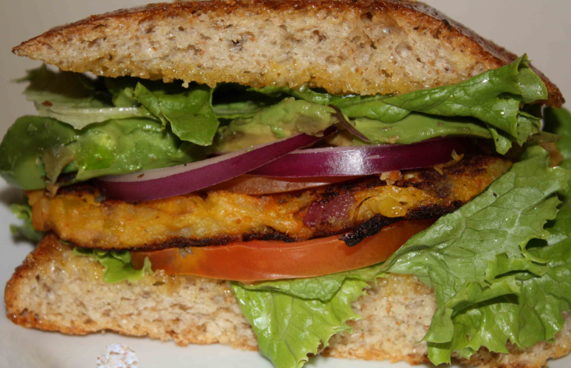
Bread
Tasty Stuff
Vegetables + Masala
Bread

Slide 6
Frameworks
Bread
J2EE
Tasty Stuff
Core Java
Bread

Slide 7
Client Tier
Business Logic Tier
Data Tier
Web Application Developed using J2EE API’s such as
JDBC
Servlets
JSP
Java Mail
etc.,
Computer
OR
Server
Computer
OR
Server
Browser
Application
DB URL
RDBMS
Application
Our Own
Computer

Slide 8
Client Tier
Business Tier
Database Tier
MySQL DB
www.gmail.com
1
Login Page
Business Logic
PHP
CGI
ASP .Net
J2EE
User ID & Password
2
Oracle DB
Inbox Page
Login Page along
with Error Info
Informix DB

